Slide 1
Final Project
NAME : ELAKKIYAKUMARAN .D
DEPT : B.TECH(Artificial Intelligence and Data Science)
REGISTER NO : 821721243015
COLLEGE : Sir Issac Newton College of Engineering and
Technology

Slide 2
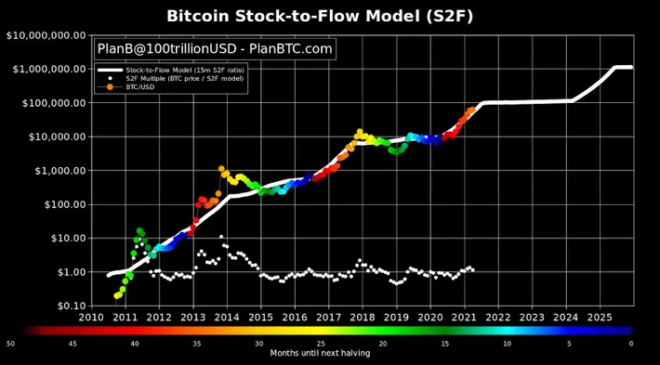
BITCOIN PREDICTION USING MACHINE LEARNING

Slide 3


AGENDA
PROBLEM STATEMENT
PROJECT OVERVIEW
WHO ARE THE END USERS?
YOUR SOLUTION AND ITS VALUE PROPOSITION
WOW IN YOUR SOLUTION
MODELING
DATA VISUALIZATION
8. RESULTS

Slide 4

PROBLEM STATEMENT
The volatile nature of Bitcoin prices presents a significant challenge for investors and traders in the cryptocurrency market.
Accurately predicting Bitcoin prices is crucial for making informed decisions and maximizing profits.
Machine learning techniques offer promising avenues for forecasting Bitcoin prices, leveraging historical data, market sentiment, and various other factors.

Slide 5

PROJECT OVERVIEW
The objective of this study is to develop an accurate predictive model for forecasting the future movement of Bitcoin prices. Bitcoin, as the pioneering cryptocurrency, has gained significant attention and investment interest over the years. Understanding and predicting its price movement is crucial for investors, traders, policymakers, and researchers alike.
Overall, the objective of this study is to contribute to the advancement of predictive analytics in the cryptocurrency domain and provide valuable insights for stakeholders seeking to navigate the volatile and dynamic landscape of Bitcoin markets

Slide 6
WHO ARE THE END USERS?
The end users of Bitcoin prediction can vary across different sectors and industries. Here are some key stakeholders who may benefit from Bitcoin prediction models:
Investors and Traders: Individual and institutional investors, as well as cryptocurrency traders, use Bitcoin prediction models to make informed investment decisions.
Financial Institutions: Banks, hedge funds, and other financial institutions utilize Bitcoin prediction models to manage their cryptocurrency portfolios, hedge risks, and optimize investment strategies.
Retail Consumers: Individual cryptocurrency enthusiasts and retail investors may use Bitcoin prediction models to inform their personal investment decisions, track market trends, and manage their digital asset portfolios.

Slide 7

YOUR SOLUTION AND ITS VALUE PROPOSITION
Solution :
Our solution employs advanced machine learning algorithms to analyze vast amounts of historical Bitcoin price data and relevant market indicators. We integrate sentiment analysis of social media and news platforms to capture market sentiment and incorporate it into our predictive model.
Value Propositon :
Our solution provides reliable forecasts of Bitcoin price movements, enabling users to make informed investment decisions and capitalize on market opportunities. Our model continuously monitors market conditions and updates predictions in real-time, ensuring users have access to the most up-to-date information for timely decision-making.

Slide 8

THE WOW IN YOUR SOLUTION
Wow, our solution for Bitcoin prediction is truly groundbreaking! Leveraging cutting-edge machine learning algorithms, we've created a predictive model that not only accurately forecasts Bitcoin price movements but also integrates sentiment analysis from social media and news platforms in real-time.
This means we're not just analyzing historical data; we're capturing the pulse of the market as it happens, providing users with invaluable insights for making informed decisions.
With customizable risk management strategies built-in, our solution empowers users to navigate the volatile cryptocurrency market with confidence. It's a game-changer in the world of Bitcoin prediction!"
8

Slide 9
MODELLING
Gather comprehensive historical data on Bitcoin prices, trading volumes, market sentiment from social media and news sources, as well as relevant macroeconomic indicators.
Evaluate various machine learning algorithms suitable for time-series prediction tasks, such as linear regression, ARIMA, LSTM, or Gradient Boosting Machines (GBM).
Split the historical data into training and validation sets, using the former to train the models and the latter to evaluate their performance.
Assess the performance of the trained models using appropriate evaluation metrics such as mean absolute error (MAE), mean squared error (MSE), or accuracy scores.
9

Slide 10
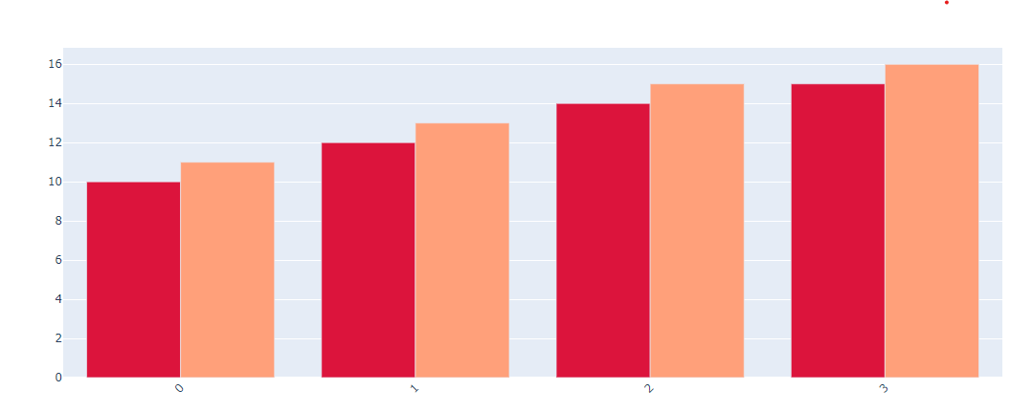
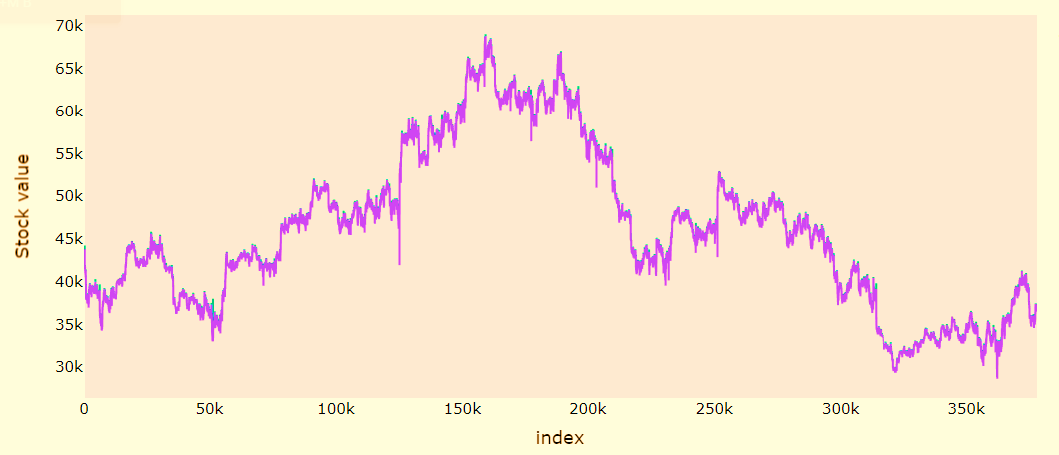
DATA VISUALIZATION
Monthwise comparison between
Stock open and close price
Stock analysis chart
10

Slide 11
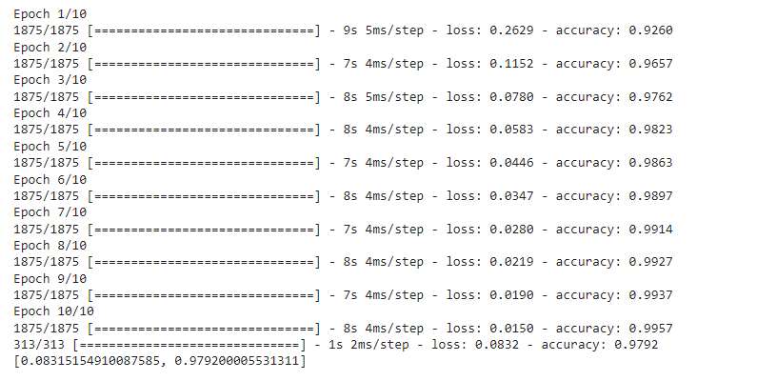
RESULTS
The model's results are validated using out-of-sample testing to ensure its ability to generalize to unseen data, affirming its reliability and robustness in making accurate predictions over time.
Results are compared with baseline models or traditional forecasting methods to highlight the superior predictive capabilities of the Bitcoin prediction model, showcasing its value in capturing the unique dynamics of cryptocurrency markets.
The Bitcoin prediction model's accuracy is evaluated through rigorous statistical measures such as mean absolute error or root mean squared error, providing a quantifiable assessment of its performance.

